Slide 1

ICU Bed Assignment Optimisation Using Genetic Algorithm
Reg no: 12219118 Name: karri Deepak seshu reddy
Sec: K22KR
Roll no: 54
Reg no: 12216832
Name: Makke prem Venkata sai charan
Sec: K22KR
Roll no: 52
Course: Soft Computing | Technique: Genetic Algorithm
Datasets: 150 training patients, 40 ICU beds, 40 test patients

Slide 2
The Challenge of ICU Resource Allocation
Critical Healthcare Problem
Our Objective
Intensive care units face mounting pressure from limited bed capacity whilst managing critically ill patients with varying severity levels. Beds differ significantly in capabilities—ventilator availability, specialised equipment, and assigned nursing staff—creating a complex matching problem.
Develop an intelligent bed assignment system using genetic algorithms to optimise:
Maximum patient survival probability
Appropriate bed-resource utilisation
Balanced nurse workload distribution
Manual bed assignment processes are inherently slow, susceptible to human bias, and struggle to account for multiple competing factors simultaneously. During peak demand periods, suboptimal assignments can compromise patient outcomes.
Robust handling of uncertain patient data
This soft computing approach transforms ICU allocation from reactive decision-making into proactive, data-driven optimisation.

Slide 3

Dataset Architecture
Training Dataset
ICU Bed Dataset
Testing Dataset
150 patients with comprehensive profiles:
40 ICU beds characterised by:
40 unseen patients reserved for model validation:
Risk level (1–10 scale)
Ventilator availability (binary)
Vital sign severity metrics
Specialty suitability mapping
Same feature structure
Age and comorbidity count (0–5)
Assigned nurse group (0–3)
Independent distribution
Doctor recommendation score (1–10)
Equipment capabilities
Generalisation assessment
Computed priority classification
Real-world performance measure

Slide 4
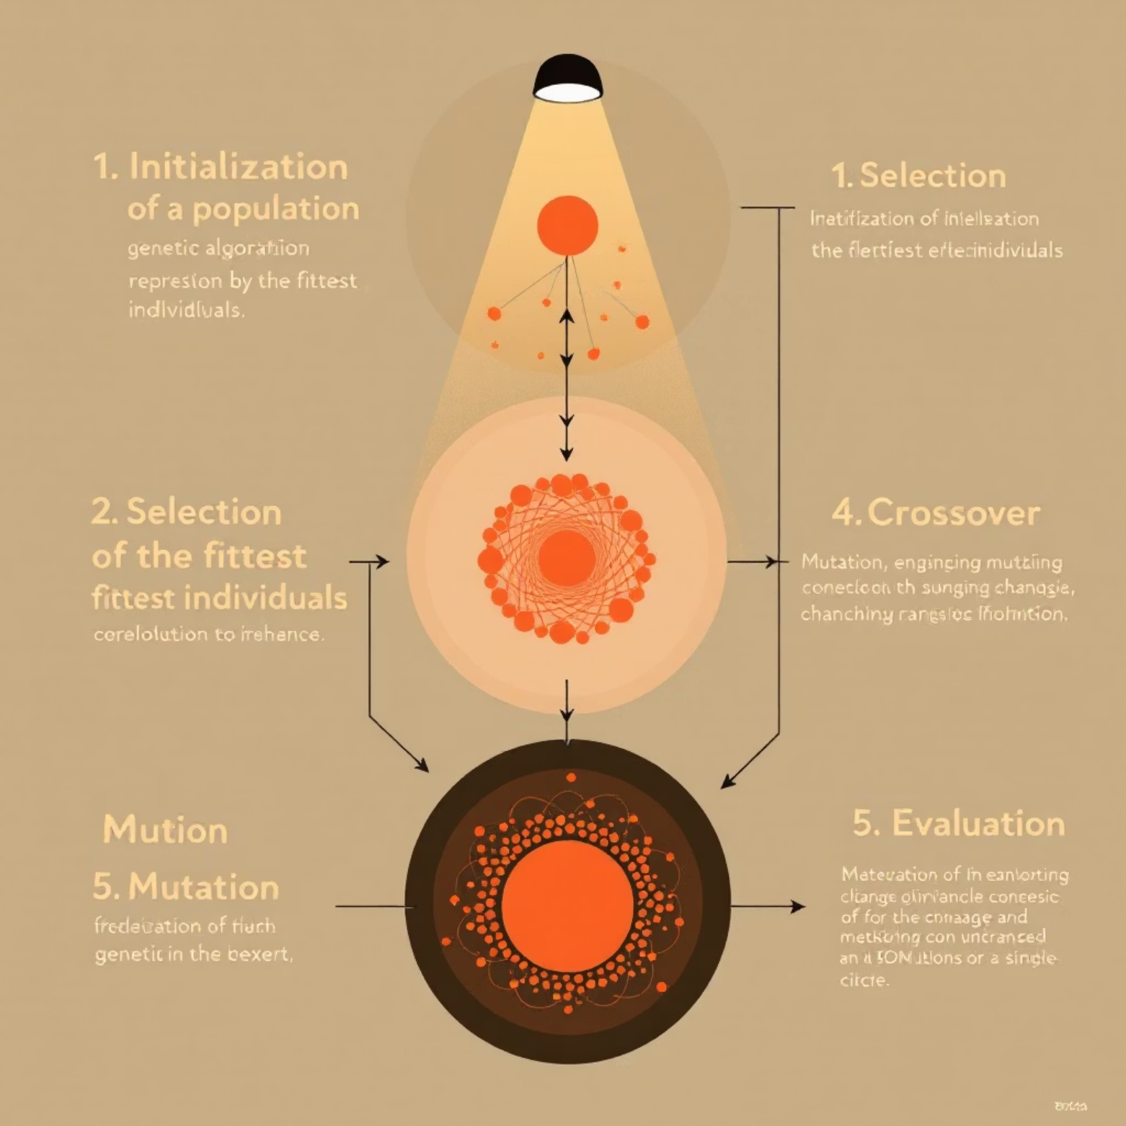
Genetic Algorithm Approach
Why Genetic Algorithms?
Core GA Components
Traditional optimisation methods struggle with the combinatorial explosion of assigning 40 patients to 40 beds—yielding over 10^47 possible configurations. Genetic algorithms excel in navigating vast search spaces without exhaustive enumeration.
01
Chromosome Encoding
GA's evolutionary approach handles uncertainty in patient vitals and adapts to dynamic constraints, making it ideal for healthcare scenarios where data is incomplete or variable.
Each solution represents a complete patient-to-bed assignment mapping
02
Fitness Function
Survival score maximisation minus nurse workload penalty
03
Selection Mechanism
Tournament selection preserves diversity whilst favouring fitter solutions
04
Genetic Operators
Crossover and mutation with repair mechanism ensure valid assignments
05
Elitism Strategy
Best solutions carry forward to prevent regression

Slide 5





Optimisation Workflow
Data Acquisition
Load patient profiles and bed specifications; compute priority scores based on risk level, vital severity, age, comorbidities, and clinical recommendations
Population Initialisation
Generate diverse random assignment solutions as starting population for evolutionary process
GA Training Phase
Execute 120 generations of selection, crossover, and mutation; evaluate each solution on survival score, bed-match quality, and nurse workload balance
Solution Extraction
Identify optimal bed assignment from final generation with highest fitness score
Model Validation
Apply trained GA parameters to 40 unseen test patients; compare training versus testing performance metrics for generalisation assessment

Slide 6
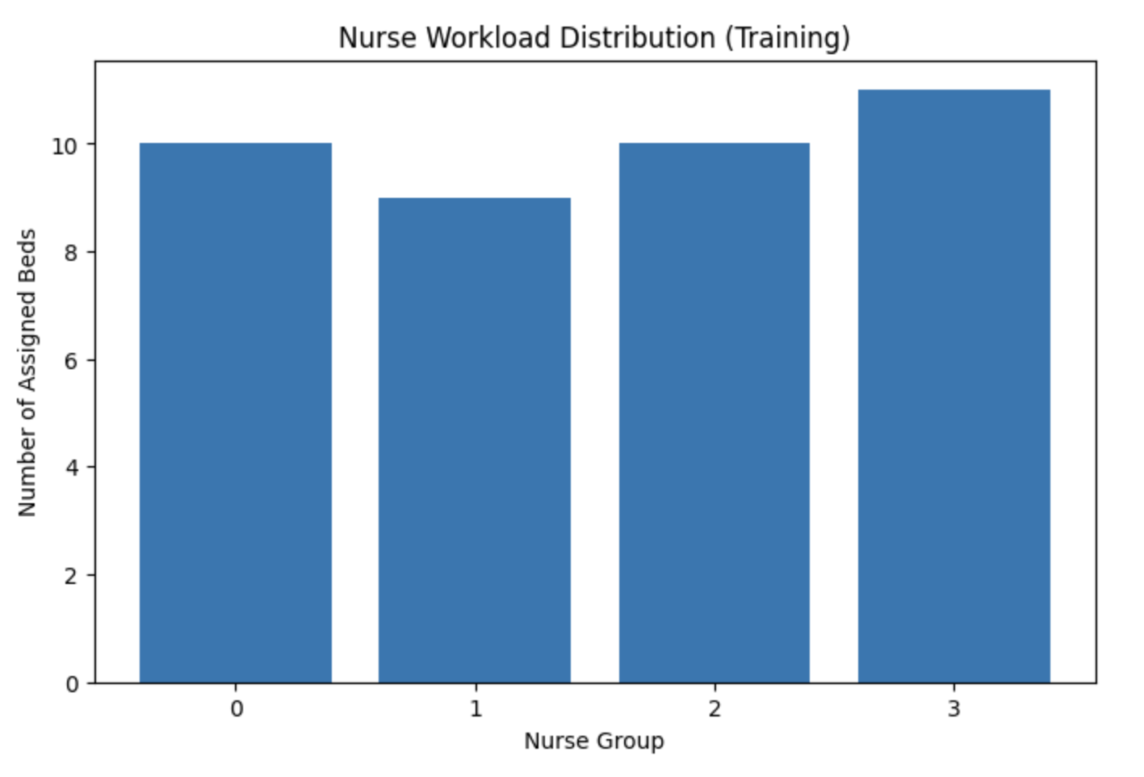
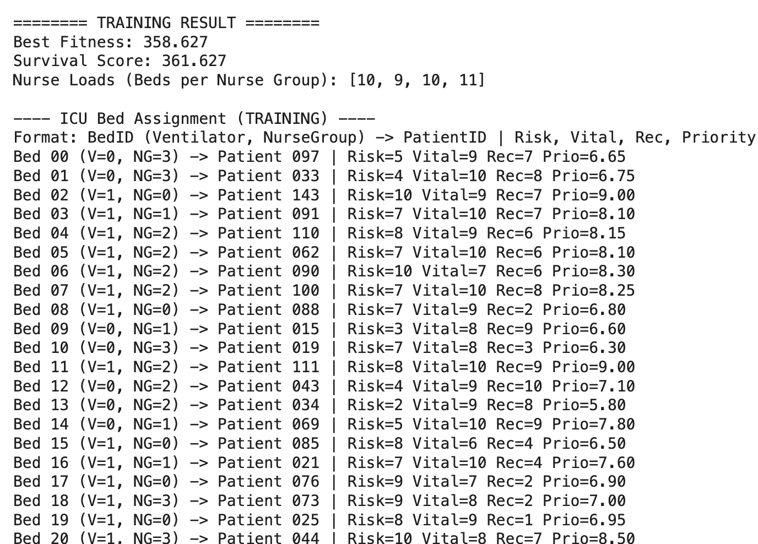
Training Results Analysis
Performance Metrics
Nurse Workload Distribution
The genetic algorithm successfully converged after 120 generations, achieving optimal bed assignments for all 150 training patients. The fitness function balanced competing objectives effectively:
Balanced allocation across all four nurse groups prevented overload scenarios:
High-priority patients secured ventilator-equipped beds
Specialty requirements matched to appropriate facilities
Critical patients assigned to experienced nurse groups
Fitness scores demonstrated consistent improvement across generations, with rapid initial gains followed by fine-tuning optimisation in later iterations.
This equitable distribution ensures sustainable staffing levels whilst maintaining care quality for all patients.

Slide 7
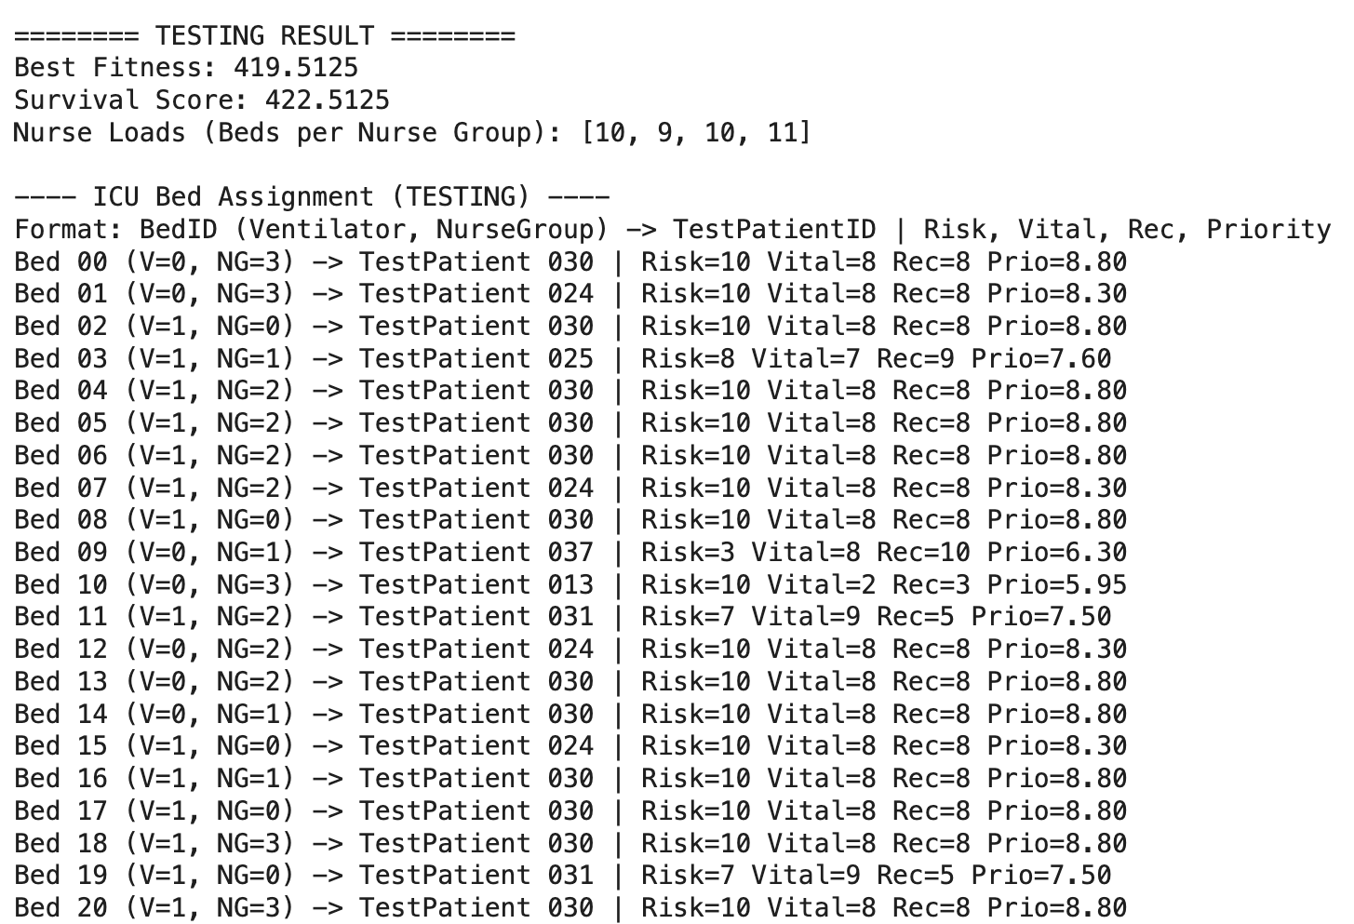
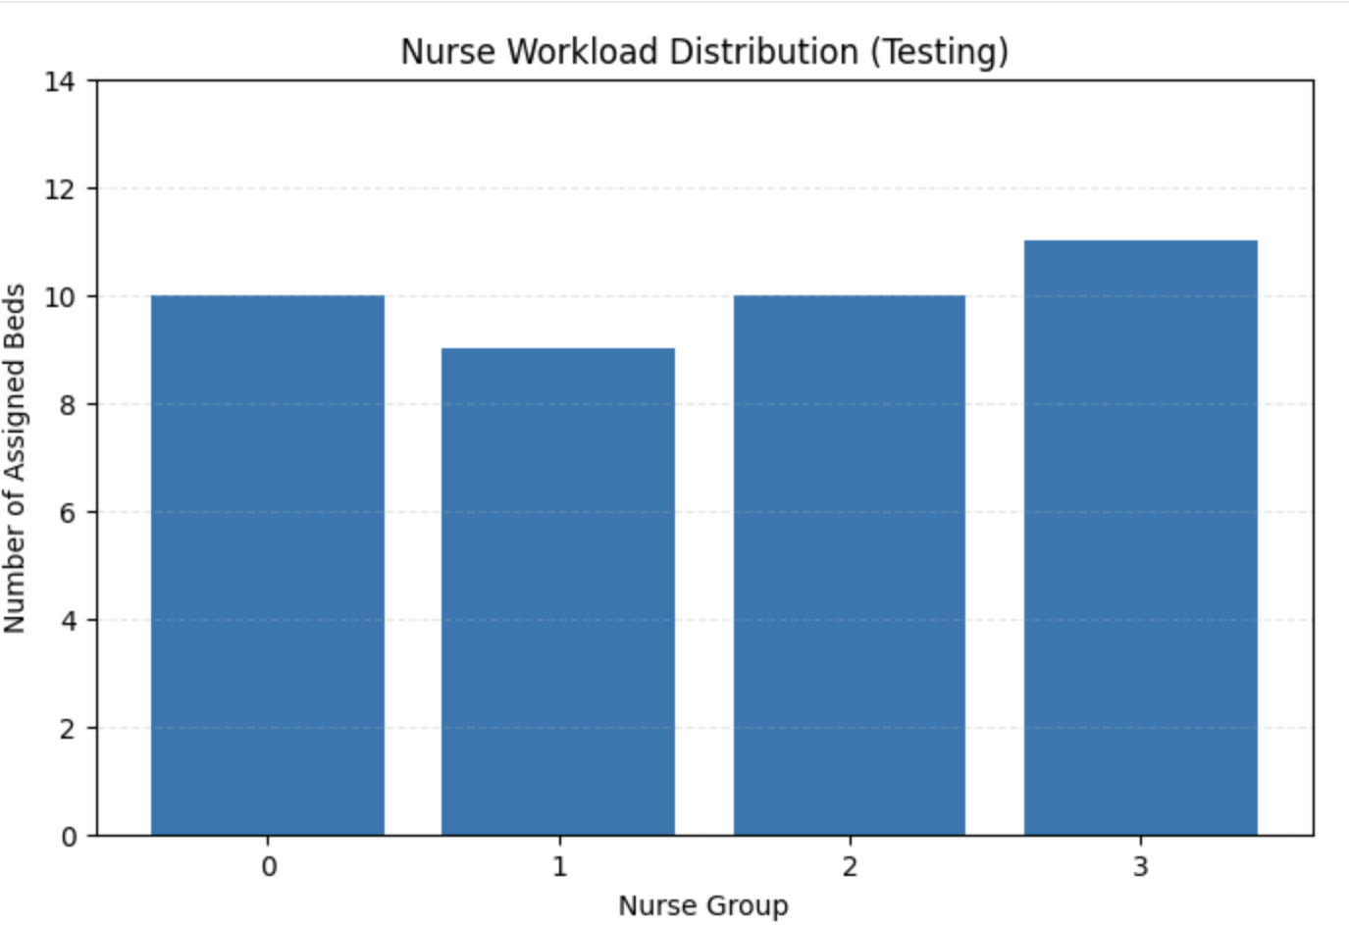
Testing Performance on Unseen Patients
Generalisation Capability
The model demonstrated robust performance on 40 previously unseen patients, validating its ability to
handle novel patient profiles. Testing results revealed:
Maintained high survival scores comparable to training phase
Appropriate bed assignments for varying risk levels
Balanced nurse workload despite different patient distribution
Effective handling of edge cases and unusual patient presentations
Each test patient received a bed assignment matching their clinical requirements—ventilator availability for respiratory cases, appropriate speciality alignment, and suitable nurse group experience levels.
Key Insights
Consistent Optimisation
Decision quality remained stable across training and testing phases
Workload Balance
Nurse distribution adapted successfully to new patient profiles
Clinical Validity
Assignments aligned with medical best practices and resource constraints

Slide 8

Conclusions and Future Directions
Future Research Directions
Key Achievements
Successful Optimisation
Genetic algorithm effectively solved the complex ICU bed
assignment problem, balancing multiple competing objectives simultaneously
Workload Equity
Achieved balanced distribution across four nurse groups, preventing
staff burnout whilst maintaining care standards
Resource Matching
Real-World Deployment: Integrate with actual hospital information systems and live patient data streams
Multi-Objective Enhancement: Implement NSGA-II for Pareto-optimal ¯ across conflicting objectives
Critical patients reliably assigned to appropriate beds with required
ventilator and speciality capabilities
Real-Time Monitoring: Incorporate IoT vital sign sensors for dynamic patient status updates
Deep Learning Integration: Develop neural networks for severity prediction and outcome forecasting
Uncertainty Quantification: Model confidence intervals for assignment recommendations
Strong Generalisation
Model performed robustly on unseen test data, demonstrating
real-world applicability

